Slide 1
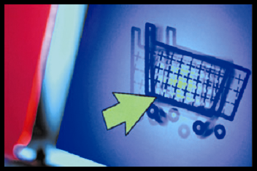
E-commerce
business. technology. society.
Second Edition
Kenneth C. Laudon
Carol Guercio Traver
Copyright © 2007 Pearson Education, Inc.
Slide 5-<number>

Slide 2
Chapter 5
Security and Encryption
Copyright © 2007 Pearson Education, Inc.
Slide 5-<number>

Slide 3
The Merchant Pays
Class Discussion
Why are offline credit card security procedures not applicable in online environment?
What new techniques are available to merchants that would reduce credit card fraud?
Why should the merchant bear the risk of online credit purchases? Why not the issuing banks?
What other steps can merchants take to reduce credit card fraud at their sites?
Why are merchants reluctant to add additional security measures?
Copyright © 2007 Pearson Education, Inc.
Slide 5-<number>

Slide 4
The E-commerce Security Environment: The Scope of the Problem
Overall size of cybercrime unclear; amount of losses significant but stable; individuals face new risks of fraud that may involve substantial uninsured losses
  Symantec: Over 50 overall attacks a day against business firms between July 2004–June 2005
  2005 Computer Security Institute survey
    56% of respondents had detected breaches of computer security within last 12 months and 91% of these suffered financial loss as a result
    Over 35% experienced denial of service attacks
    Over 75% detected virus attacks
Copyright © 2007 Pearson Education, Inc.
Slide 5-<number>

Slide 5
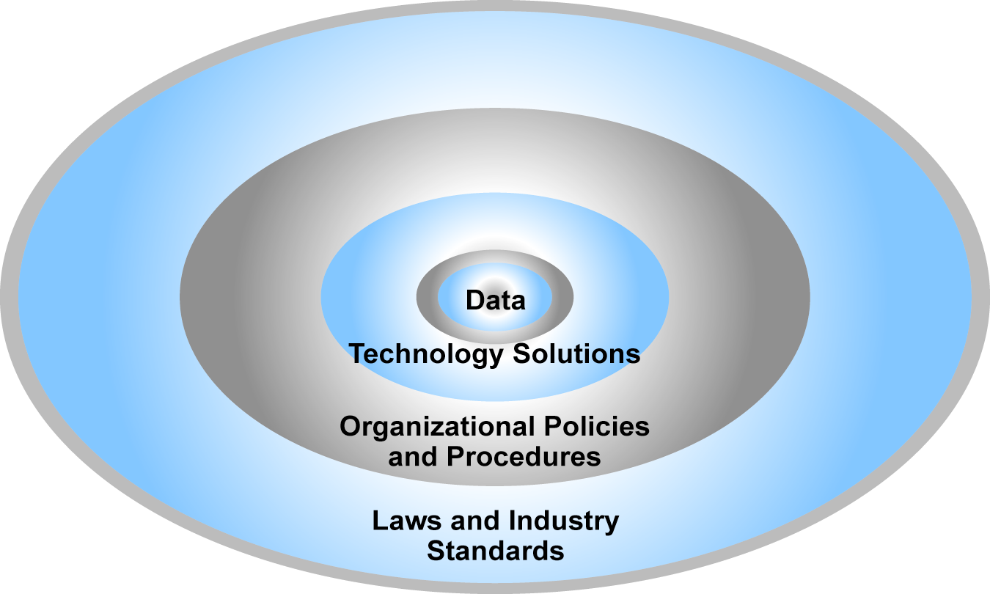
The E-commerce Security Environment
Figure 5.4, Page 253
Copyright © 2007 Pearson Education, Inc.
Slide 5-<number>

Slide 6
Dimensions of E-commerce Security
Integrity: ability to ensure that information being displayed on a Web site or transmitted/received over the Internet has not been altered in any way by an unauthorized party
Nonrepudiation: ability to ensure that e-commerce participants do not deny (repudiate) online actions
Authenticity: ability to identify the identity of a person or entity with whom you are dealing on the Internet
Confidentiality: ability to ensure that messages and data are available only to those authorized to view them
Privacy: ability to control use of information a customer provides about himself or herself to merchant
Availability: ability to ensure that an e-commerce site continues to function as intended
Copyright © 2007 Pearson Education, Inc.
Slide 5-<number>

Slide 7
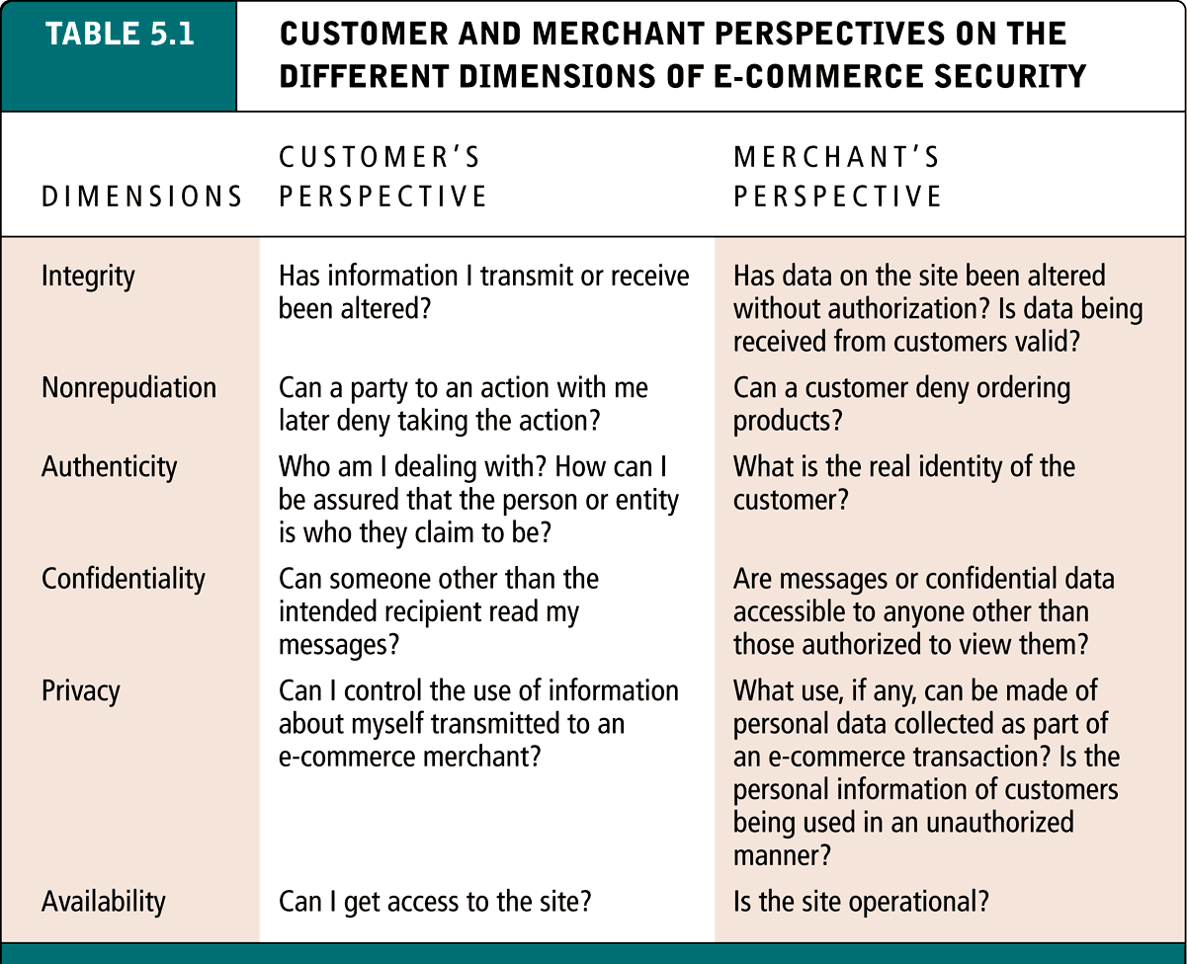
Customer and Merchant Perspectives on the Different Dimensions of E-commerce Security
Table 5.1, Page 254
Copyright © 2007 Pearson Education, Inc.
Slide 5-<number>

Slide 8
The Tension Between Security and Other Values
Security vs. ease of use: the more security measures that are added, the more difficult a site is to use, and the slower it becomes
Security vs. desire of individuals to act anonymously
Copyright © 2007 Pearson Education, Inc.
Slide 5-<number>

Slide 9
Security Threats in the E-commerce Environment
Three key points of vulnerability:
  Client
  Server
  Communications channel
Copyright © 2007 Pearson Education, Inc.
Slide 5-<number>

Slide 10
Security Threats in the E-commerce Environment (cont’d)
Most common threats:
  Malicious code
  Phishing
  Hacking and cybervandalism
  Credit card fraud/theft
  Spoofing (pharming)
  Denial of service attacks
  Sniffing
  Insider jobs
  Poorly designed server and client software
Copyright © 2007 Pearson Education, Inc.
Slide 5-<number>

Slide 11
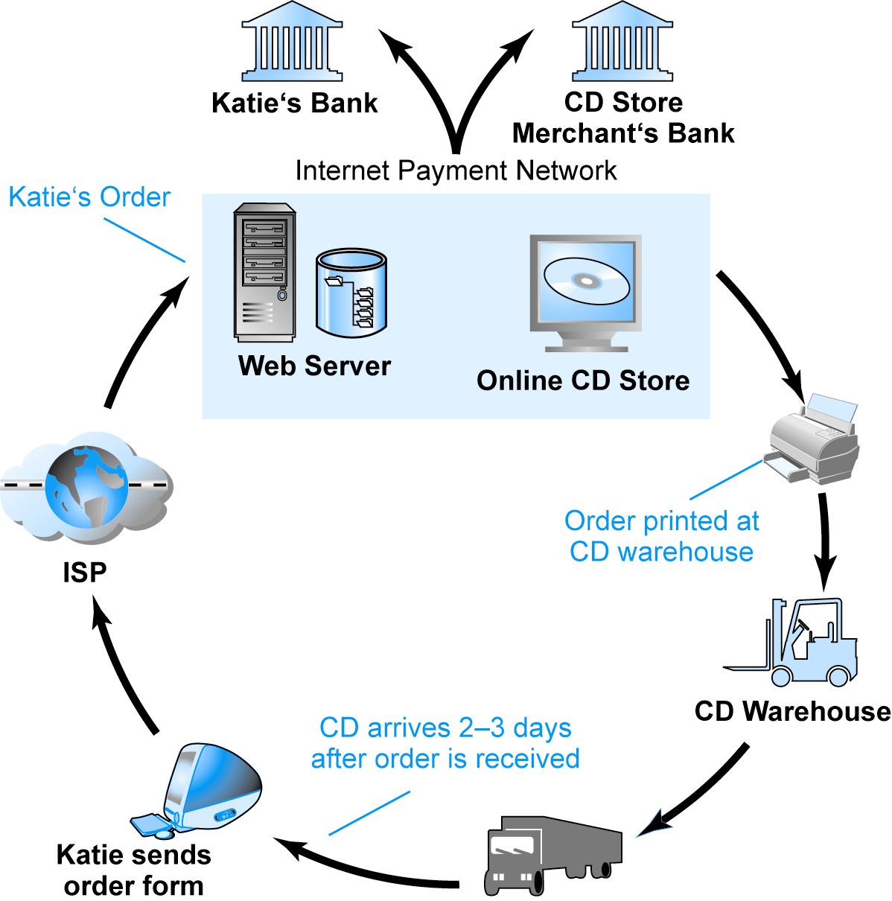
A Typical E-commerce Transaction
Figure 5.5, Page 257
SOURCE: Boncella, 2000.
Copyright © 2007 Pearson Education, Inc.
Slide 5-<number>

Slide 12
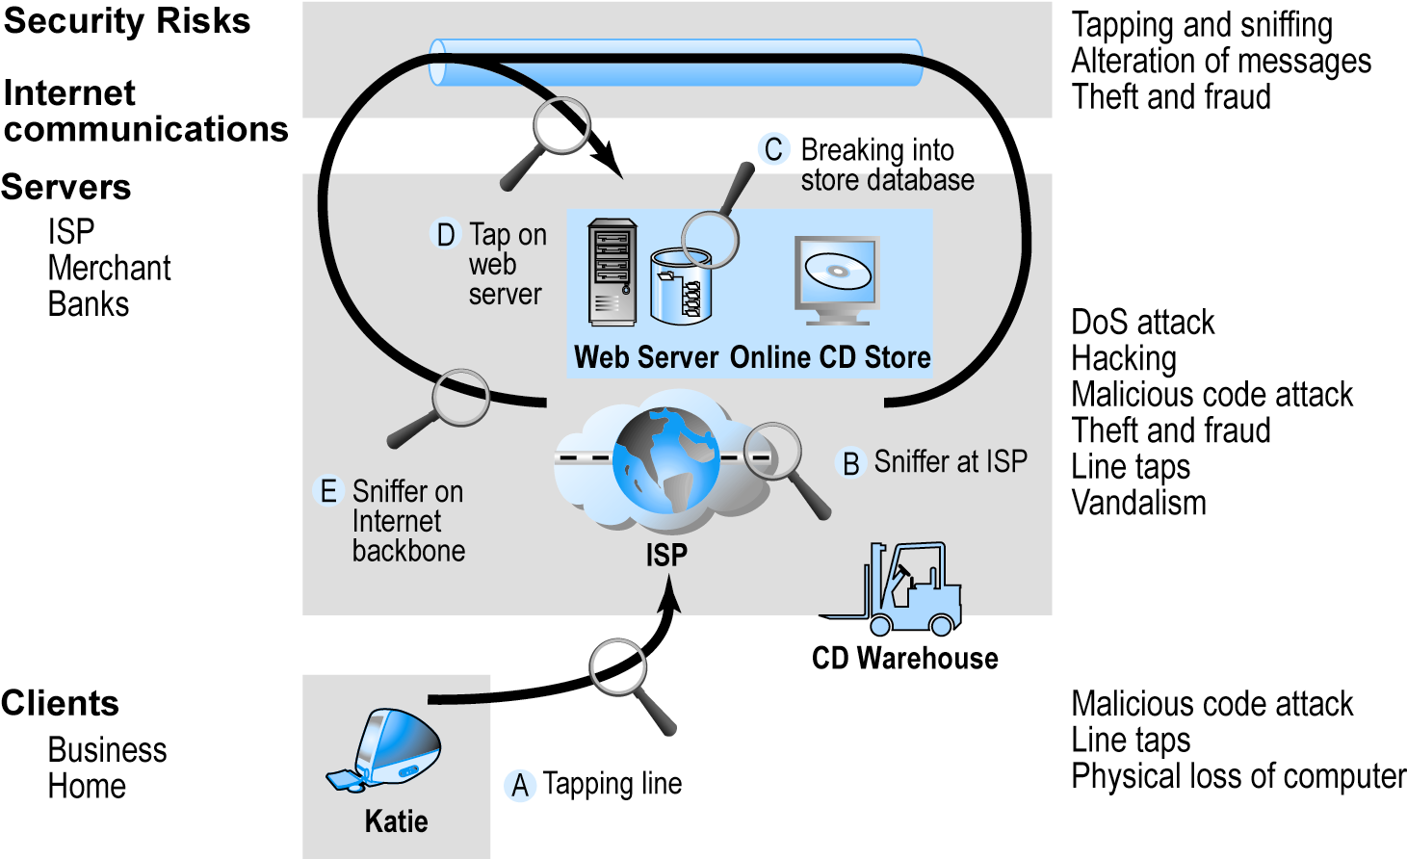
Vulnerable Points in an E-commerce Environment
Figure 5.6, Page 258
SOURCE: Boncella, 2000.
Copyright © 2007 Pearson Education, Inc.
Slide 5-<number>

Slide 13
Malicious Code
Viruses: computer program that has ability to replicate and spread to other files; most also deliver a “payload” of some sort (may be destructive or benign); include macro viruses, file-infecting viruses, and script viruses
Worms: designed to spread from computer to computer
Trojan horse: appears to be benign, but then does something other than expected
Bots: can be covertly installed on computer; responds to external commands sent by the attacker
Copyright © 2007 Pearson Education, Inc.
Slide 5-<number>

Slide 14
Phishing
Any deceptive, online attempt by a third party to obtain confidential information for financial gain
  Most popular type: e-mail scam letter
  One of fastest growing forms of e-commerce crime
Copyright © 2007 Pearson Education, Inc.
Slide 5-<number>

Slide 15
Hacking and Cybervandalism
Hacker: Individual who intends to gain unauthorized access to computer systems
Cracker: Used to denote hacker with criminal intent (two terms often used interchangeably)
Cybervandalism: Intentionally disrupting, defacing or destroying a Web site
Types of hackers include:
  White hats
  Black hats
  Grey hats
Copyright © 2007 Pearson Education, Inc.
Slide 5-<number>

Slide 16
Credit Card Fraud
Fear that credit card information will be stolen deters online purchases
Hackers target credit card files and other customer information files on merchant servers; use stolen data to establish credit under false identity
One solution: New identity verification mechanisms
Copyright © 2007 Pearson Education, Inc.
Slide 5-<number>

Slide 17
Insight on Society: “Evil Twins” and “Pharming”: Keeping Up with the Hackers?
Class Discussion
What are “evil twins” and “pharming”
What is meant by “social engineering techniques?”
What is the security weakness in the domain name system that permits pharming?
What steps can users take to verify they are communicating with authentic sites and networks?
Copyright © 2007 Pearson Education, Inc.
Slide 5-<number>

Slide 18
Spoofing (Pharming)
Misrepresenting oneself by using fake e-mail addresses or masquerading as someone else
Threatens integrity of site; authenticity
Copyright © 2007 Pearson Education, Inc.
Slide 5-<number>

Slide 19
DoS and dDoS Attacks
Denial of service (DoS) attack: Hackers flood Web site with useless traffic to inundate and overwhelm network
Distributed denial of service (dDoS) attack: hackers use numerous computers to attack target network from numerous launch points
Copyright © 2007 Pearson Education, Inc.
Slide 5-<number>

Slide 20
Other Security Threats
Sniffing: Type of eavesdropping program that monitors information traveling over a network; enables hackers to steal proprietary information from anywhere on a network
Insider jobs: Single largest financial threat
Poorly designed server and client software: Increase in complexity of software programs has contributed to an increase is vulnerabilities that hackers can exploit
Copyright © 2007 Pearson Education, Inc.
Slide 5-<number>

Slide 21
Technology Solutions
Protecting Internet communications (encryption)
Securing channels of communication (SSL, S-HTTP, VPNs)
Protecting networks (firewalls)
Protecting servers and clients
Copyright © 2007 Pearson Education, Inc.
Slide 5-<number>

Slide 22
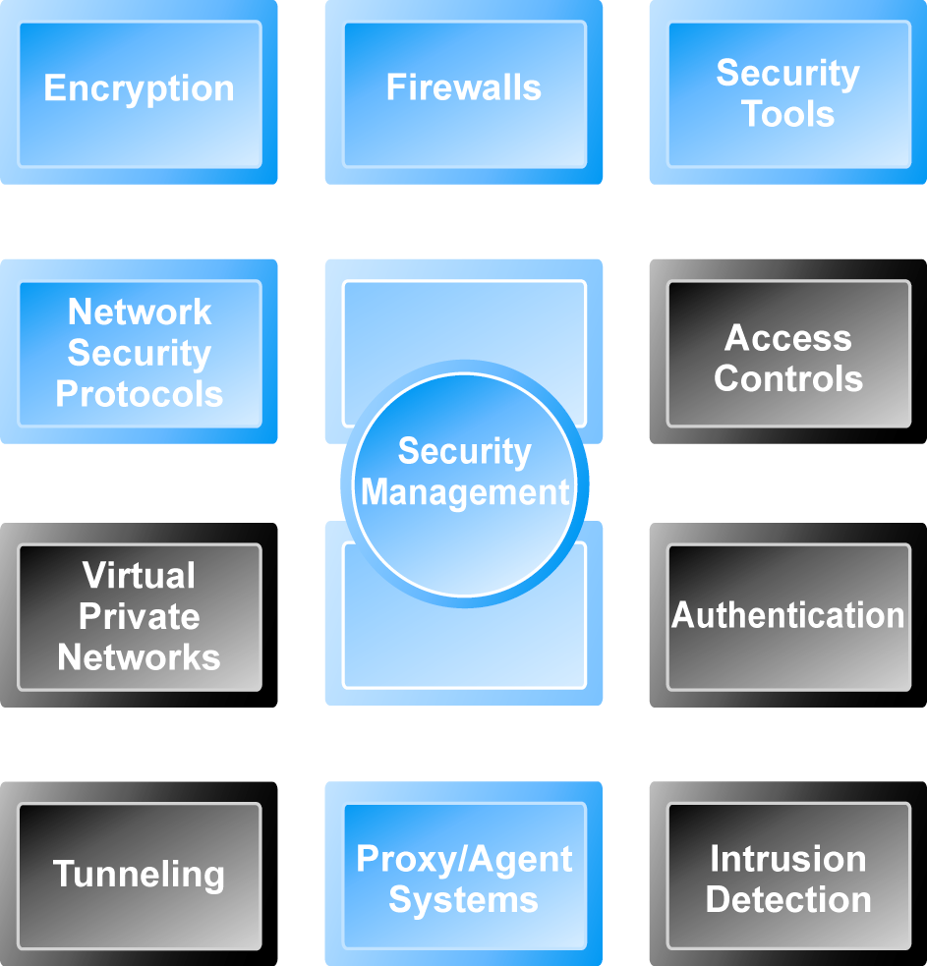
Tools Available to Achieve Site Security
Figure 5.7, Page 269
Copyright © 2007 Pearson Education, Inc.
Slide 5-<number>

Slide 23
Protecting Internet Communications: Encryption
Encryption: The process of transforming plain text or data into cipher text that cannot be read by anyone other than the sender and receiver
Purpose: Secure stored information and information transmission
Provides:
  Message integrity
  Nonrepudiation
  Authentication
  Confidentiality
Copyright © 2007 Pearson Education, Inc.
Slide 5-<number>

Slide 24
Symmetric Key Encryption
Also known as secret key encryption
Both the sender and receiver use the same digital key to encrypt and decrypt message
Requires a different set of keys for each transaction
Data Encryption Standard (DES): Most widely used symmetric key encryption today; uses 56-bit encryption key; other types use 128-bit keys up through 2048 bits
Copyright © 2007 Pearson Education, Inc.
Slide 5-<number>

Slide 25
Public Key Encryption
Public key cryptography solves symmetric key encryption problem of having to exchange secret key
Uses two mathematically related digital keys – public key (widely disseminated) and private key (kept secret by owner)
Both keys are used to encrypt and decrypt message
Once key is used to encrypt message, same key cannot be used to decrypt message
For example, sender uses recipient’s public key to encrypt message; recipient uses his/her private key to decrypt it
Copyright © 2007 Pearson Education, Inc.
Slide 5-<number>

Slide 26
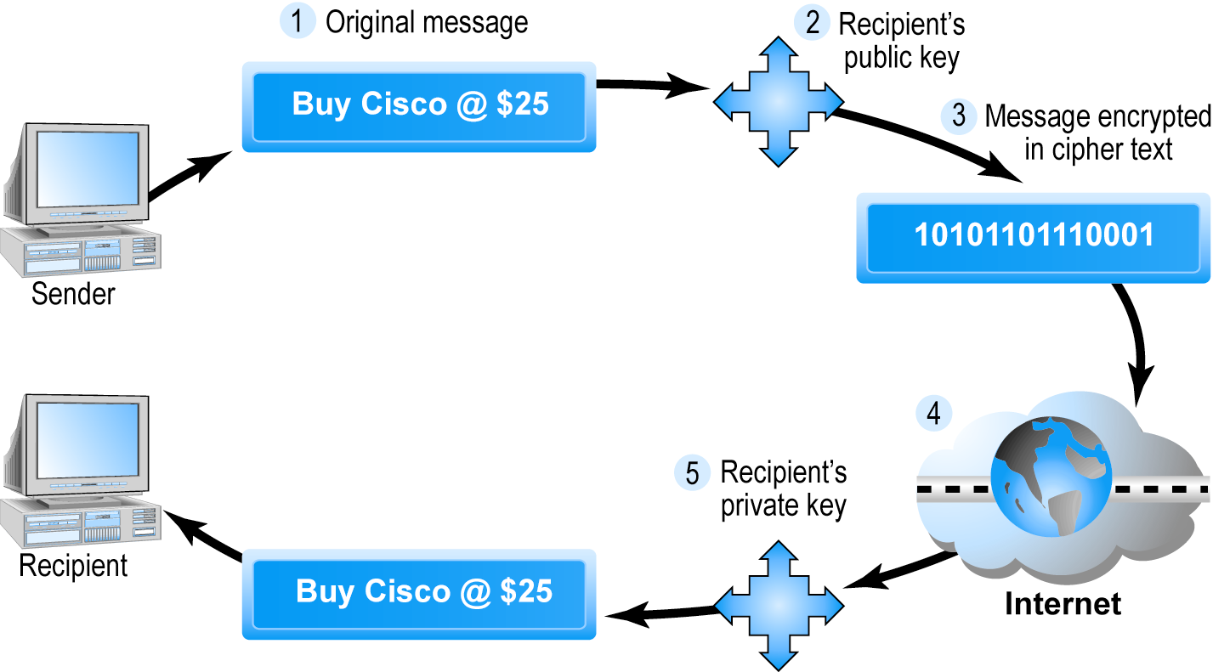
Public Key Cryptography – A Simple Case
Figure 5.8, Page 272
Copyright © 2007 Pearson Education, Inc.
Slide 5-<number>

Slide 27
Public Key Encryption using Digital Signatures and Hash Digests
Application of hash function (mathematical algorithm) by sender prior to encryption produces hash digest that recipient can use to verify integrity of data
Double encryption with sender’s private key (digital signature) helps ensure authenticity and nonrepudiation
Copyright © 2007 Pearson Education, Inc.
Slide 5-<number>

Slide 28
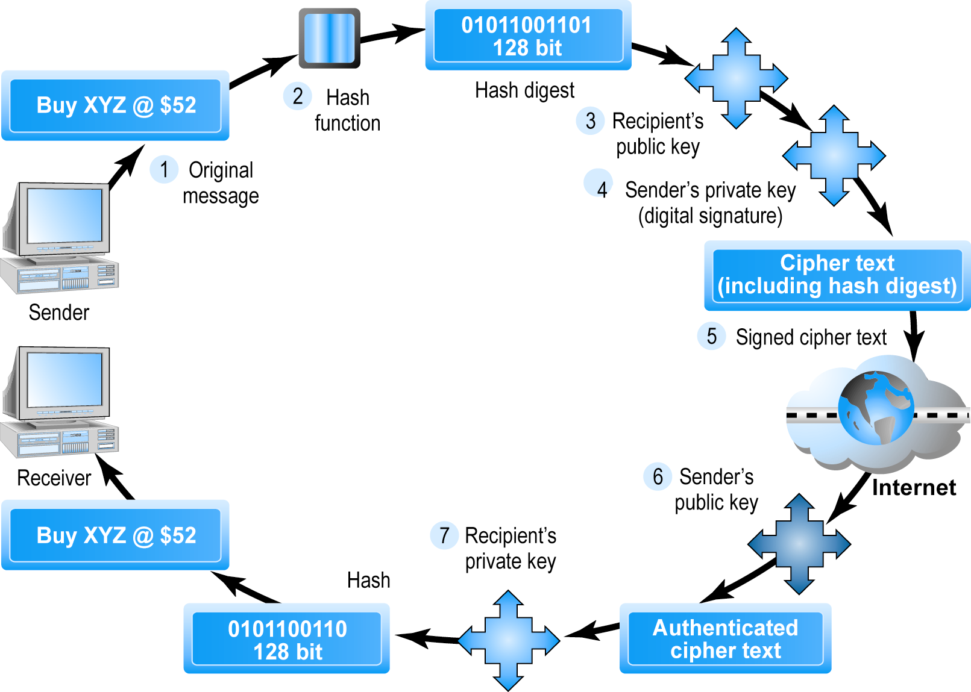
Public Key Cryptography with Digital Signatures
Figure 5.9, Page 274
Copyright © 2007 Pearson Education, Inc.
Slide 5-<number>

Slide 29
Digital Envelopes
Addresses weaknesses of public key encryption (computationally slow, decreases transmission speed, increases processing time) and symmetric key encryption (faster, but more secure)
Uses symmetric key encryption to encrypt document but public key encryption to encrypt and send symmetric key
Copyright © 2007 Pearson Education, Inc.
Slide 5-<number>

Slide 30
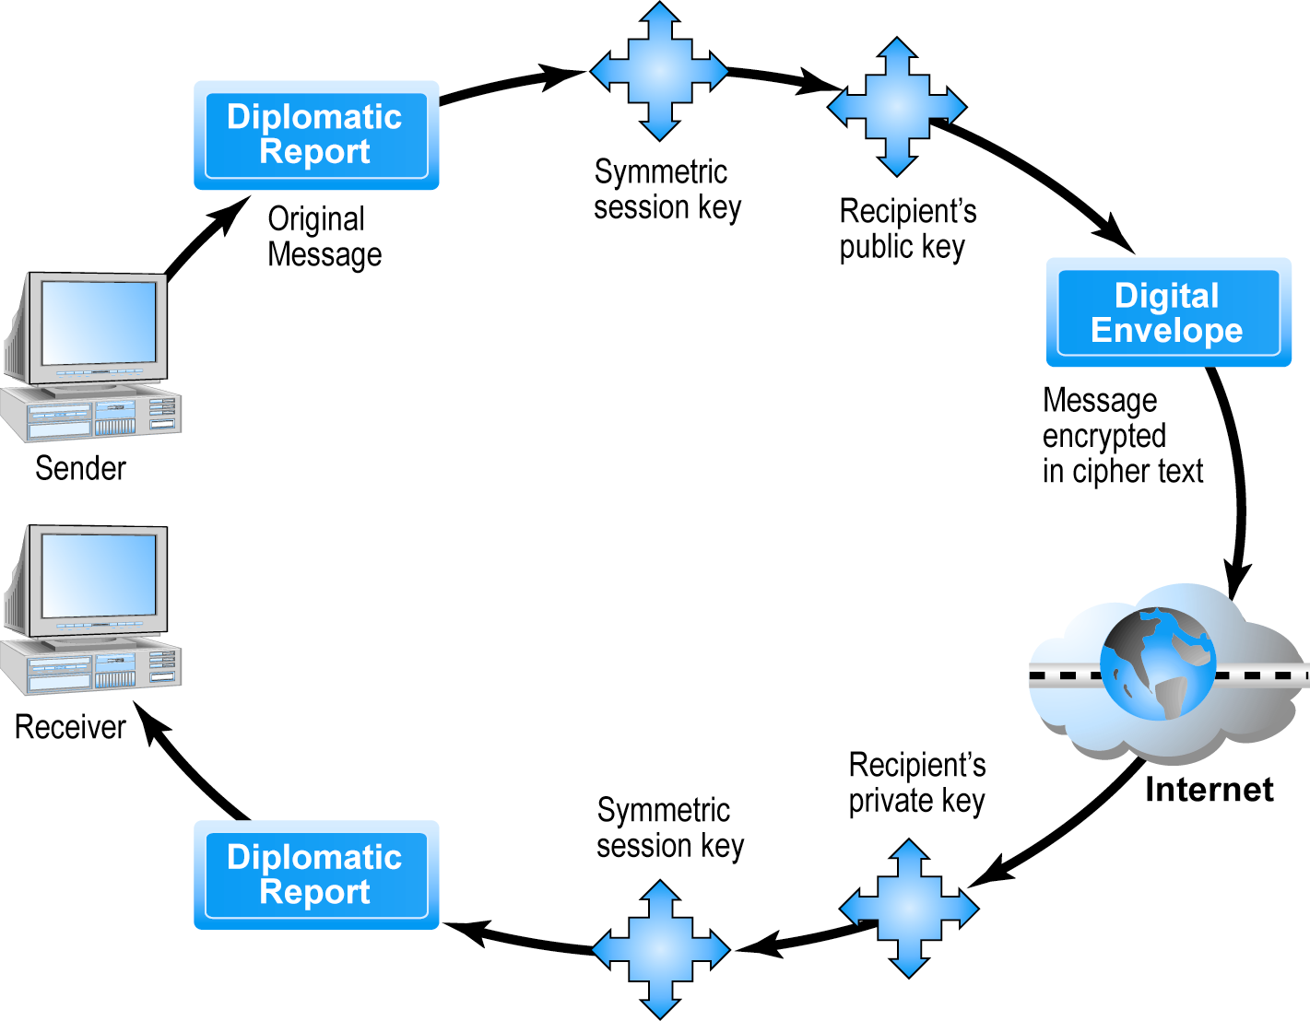
Public Key Cryptography: Creating a Digital Envelope
Figure 5.10, Page 275
Copyright © 2007 Pearson Education, Inc.
Slide 5-<number>

Slide 31
Digital Certificates and Public Key Infrastructure (PKI)
Digital certificate: Digital document that includes:
  Name of subject or company
  Subject’s public key
  Digital certificate serial number
  Expiration date
  Issuance date
  Digital signature of certification authority (trusted third party institution) that issues certificate
  Other identifying information
Public Key Infrastructure (PKI): refers to the CAs and digital certificate procedures that are accepted by all parties
Copyright © 2007 Pearson Education, Inc.
Slide 5-<number>

Slide 32
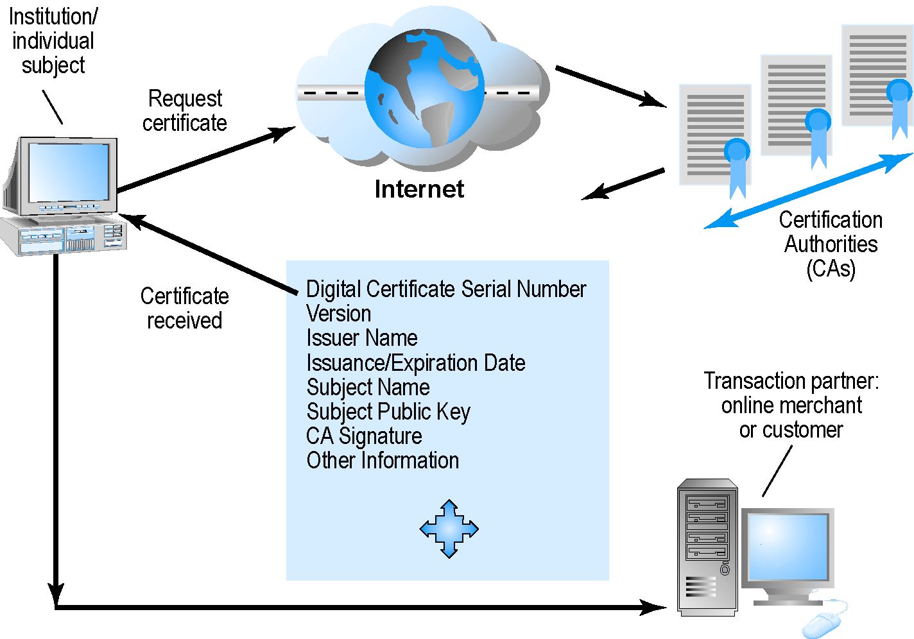
Digital Certificates and Certification Authorities
Figure 5.11, Page 277
Copyright © 2007 Pearson Education, Inc.
Slide 5-<number>

Slide 33
Limits to Encryption Solutions
PKI applies mainly to protecting messages in transit
PKI is not effective against insiders
Protection of private keys by individuals may be haphazard
No guarantee that verifying computer of merchant is secure
CAs are unregulated, self-selecting organizations
Copyright © 2007 Pearson Education, Inc.
Slide 5-<number>

Slide 34
Insight on Technology: Advances in Quantum Cryptography May Lead to the Unbreakable Key
Class Discussion
Why are existing encryption systems over time more vulnerable?
What is quantum encryption?
What is the weakness of a symmetric key system (even one based on quantum techniques)?
Would quantum-encrypted messages be immune to the growth in computing power?
Copyright © 2007 Pearson Education, Inc.
Slide 5-<number>

Slide 35
Securing Channels of Communication
Secure Sockets Layer (SSL): Most common form of securing channels of communication; used to establish a secure negotiated session (client-server session in which URL of requested document, along with contents, is encrypted)
S-HTTP: Alternative method; provides a secure message-oriented communications protocol designed for use in conjunction with HTTP
Virtual Private Networks (VPNs): Allow remote users to securely access internal networks via the Internet, using Point-to-Point Tunneling Protocol (PPTP)
Copyright © 2007 Pearson Education, Inc.
Slide 5-<number>

Slide 36
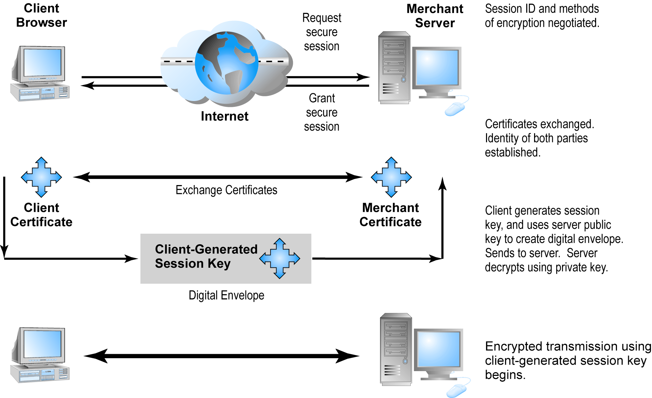
Secure Negotiated Sessions Using SSL
Figure 5.12, Page 281
Copyright © 2007 Pearson Education, Inc.
Slide 5-<number>

Slide 37
Protecting Networks: Firewalls and Proxy Servers
Firewall: Hardware or software filters communications packets and prevents some packets from entering the network based on a security policy
Firewall methods include:
  Packet filters
  Application gateways
Proxy servers: Software servers that handle all communications originating from or being sent to the Internet
Copyright © 2007 Pearson Education, Inc.
Slide 5-<number>

Slide 38
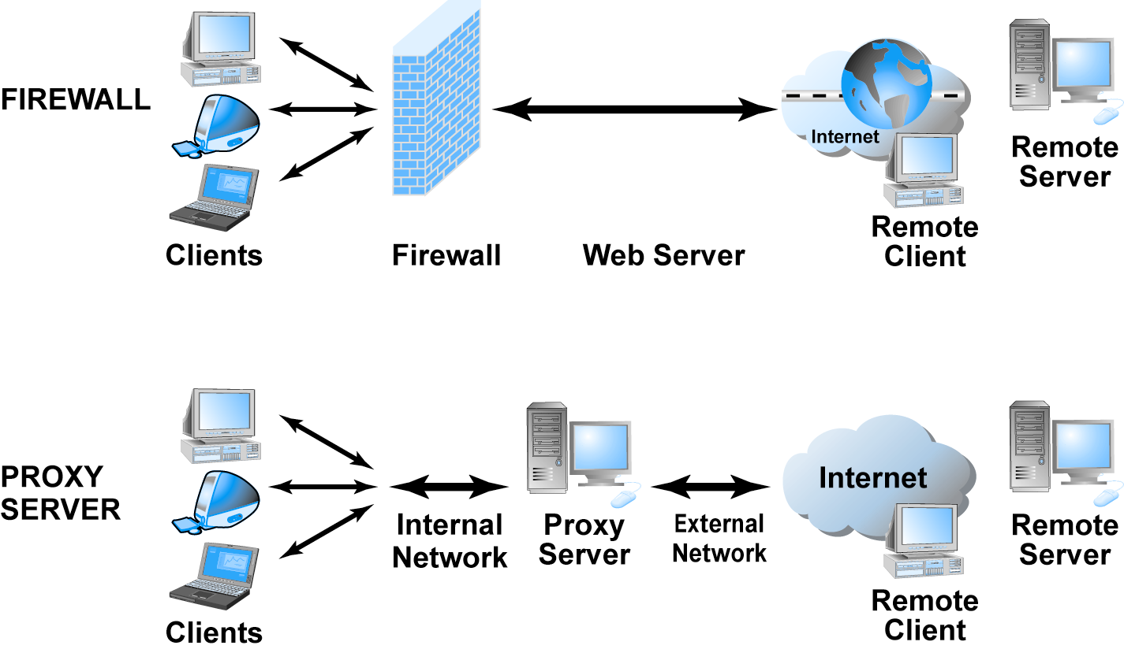
Firewalls and Proxy Servers
Figure 5.13, Page 283
Copyright © 2007 Pearson Education, Inc.
Slide 5-<number>

Slide 39
Protecting Servers and Clients
Operating system controls: Authentication and access control mechanisms
Anti-virus software: Easiest and least expensive way to prevent threats to system integrity
Copyright © 2007 Pearson Education, Inc.
Slide 5-<number>

Slide 40
A Security Plan: Management Policies
Steps in developing a security plan
  Perform risk assessment: assessment of risks and points of vulnerability
  Develop security policy: set of statements prioritizing information risks, identifying acceptable risk targets, and identifying mechanisms for achieving targets
  Develop implementation plan: action steps needed to achieve security plan goals
  Create security organization: in charge of security; educates and trains users, keeps management aware of security issues; administers access controls, authentication procedures and authorization policies
  Perform security audit: review of security practices and procedures
Copyright © 2007 Pearson Education, Inc.
Slide 5-<number>

Slide 41
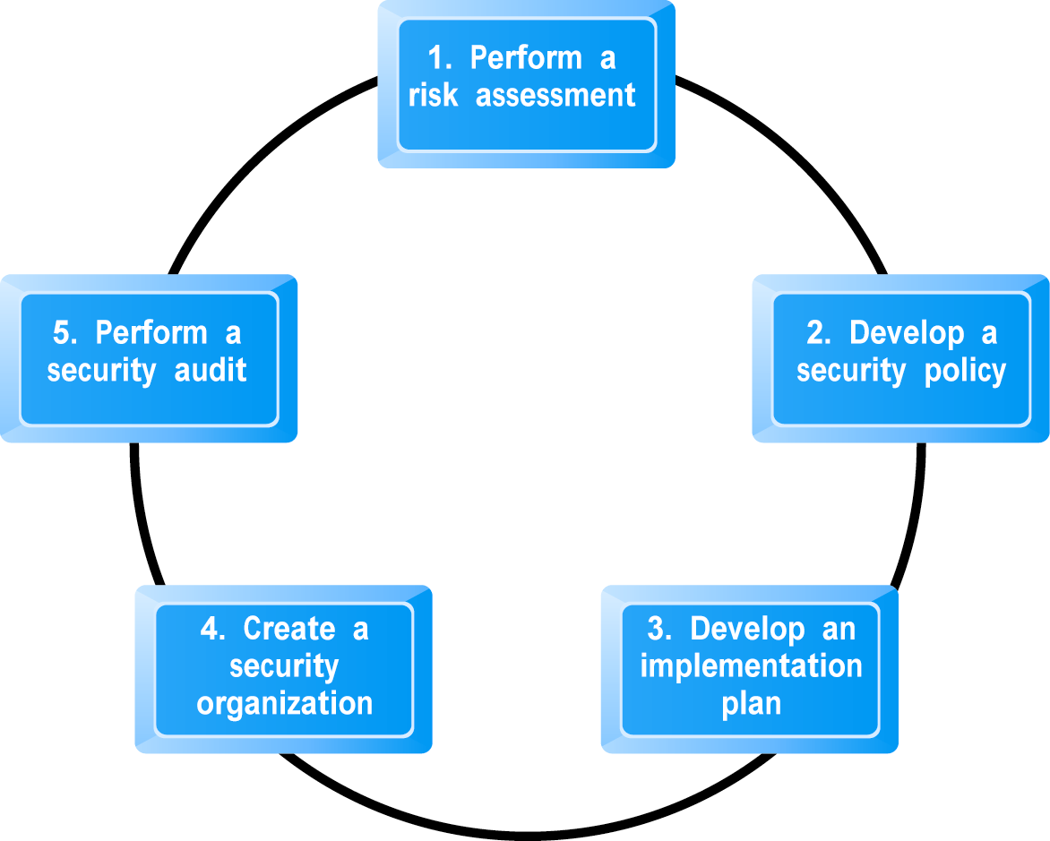
Developing an E-commerce Security Plan
Figure 5.14, Page 286
Copyright © 2007 Pearson Education, Inc.
Slide 5-<number>

Slide 42
Insight on Business: Hiring Hackers to Locate Threats: Penetration Testing
Class Discussion
Why would firms hire outsiders to crash its systems?
What are “grey” and “black” hats and why do firms avoid them as security testers?
Are penetration specialists like Johnny Long performing a public service or just making the situation worse?
Copyright © 2007 Pearson Education, Inc.
Slide 5-<number>

Slide 43
The Role of Laws and Public Policy
New laws have granted local and national authorities new tools and mechanisms for identifying, tracing and prosecuting cybercriminals
  National Infrastructure Protection Center – unit within National Cyber Security Division of Department of Homeland Security whose mission is to identify and combat threats against U.S. technology and telecommunications infrastructure
  USA Patriot Act
  Homeland Security Act
Government policies and controls on encryption software
Copyright © 2007 Pearson Education, Inc.
Slide 5-<number>

Slide 44
OECD Guidelines
2002 Organization for Economic Cooperation and Development (OECD) Guidelines for the Security of Information Systems and Networks has nine principles:
  Awareness
  Responsibility
  Response
  Ethics
  Democracy
  Risk assessment
  Security design and implementation
  Security management
  Reassessment
Copyright © 2007 Pearson Education, Inc.
Slide 5-<number>

